Slide 1



Process Modeling

Slide 2

Model – a pictorial representation of reality.
Just as a picture is worth a thousand words, most models are pictorial representations of reality.
Logical model – a nontechnical pictorial representation that depicts what a system is or does. Synonyms or
essential model,
conceptual model, and
business model.
Physical model – a technical pictorial representation that depicts what a system is or does and how the system is implemented.
Synonyms are
implementation model and
technical model.
9-2

Slide 3

 Logical models remove biases that are the
result of the way the system is currently
implemented, or the way that any one
person thinks the system might be implemented.
Logical models reduce the risk of missing
business requirements because we are too preoccupied with technical results.
Logical models allow us to communicate
with end-users in nontechnical or less technical languages.
9-3

Slide 4

Process modeling – a technique used to organize and document a system’s processes.
Flow of data through processes
Logic
Policies
Procedures
Data flow diagram (DFD) – a process model used to depict the flow of data through a system and the work or processing performed by the system.
Synonyms are bubble chart, transformation graph, and process model.
The DFD has also become a popular tool for business process redesign.
9-4

Slide 5

 Processes on DFDs can operate in parallel
(at-the-same-time)
Processes on flowcharts execute one at a time
DFDs show the flow of data through a system
Flowcharts show the flow of control (sequence and transfer of control)
Processes on a DFD can have dramatically different timing (daily, weekly, on demand)
Processes on flowcharts are part of a single program with consistent timing
9-5

Slide 6



External agent – an outside person, unit,
system, or organization that interacts with a system. Also called an external entity.
External agents define the “boundary” or scope of a system being modeled.
As scope changes, external agents can become processes, and vice versa.
Almost always one of the following:
Office, department, division.
An external organization or agency.
Another business or another information system.
One of system’s end-users or managers
Named with descriptive, singular nou_{D}n_{eMarco/Yourdon shape}
Gane and Sarson shape
9-6

Slide 7



Data store – stored data intended for
later use. Synonyms are file and
database.
Frequently implemented as a file or database.
A data store is “data at rest” compared to a
data flow that is “data in motion.”
Almost always one of the following:
Persons (or groups of persons)
Places
Objects
Events (about which data is captured)
Gane and Sarson shape
 Concepts (about which data is important)
Data stores depicted on a DFD store all instances of data entities
(depicted on an ERD)
Named with plural noun
DeMarco/Yourdon shape
9-7

Slide 8

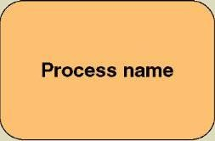
Process – work performed by a system in
response to incoming data flows or conditions.
A synonym is transform.
All information systems include processes - usually many of them
Processes respond to business events and conditions and transform data into useful information
Gane and Sarson shape
Modeling processes helps us to understand the interactions with the system's environment, other systems, and other processes.
Named with a strong action verb followed by object clause describing what the work is performed on/for .
9-8

Slide 9

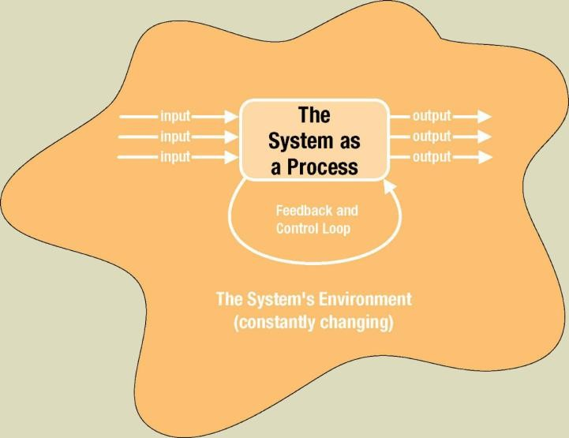

Slide 10

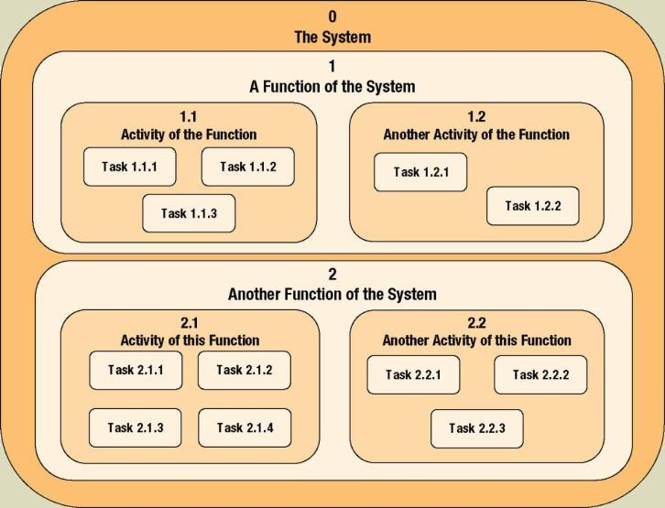
Decomposition – the act of breaking a system into sub-components. Each level of abstraction reveals more or less detail.

Slide 11

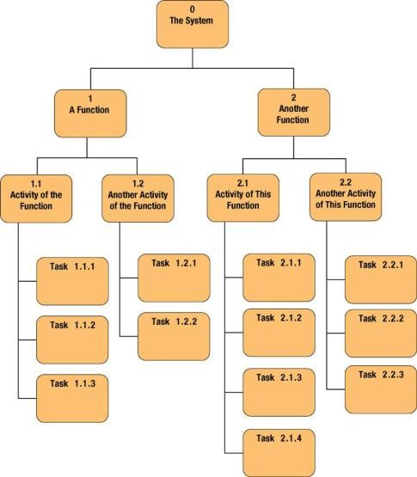
Decomposition diagram – a tool used to depict the decomposition of a system. Also called hierarchy chart.

Slide 12

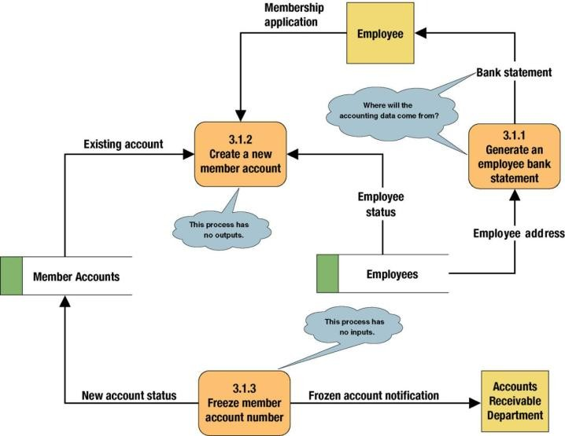

Slide 13

Data flow – data that is input to or output from a process.
A data flow is data in motion
A data flow may also be used to represent the creation, reading, deletion, or updating of data in a file
Data flow name
or database (called a data store).
Composite data flow – a data flow that consists of other data flows.
Control flow – a condition or nondata event that triggers a process.
Used sparingly on DFDs.
Control flow name

Slide 14

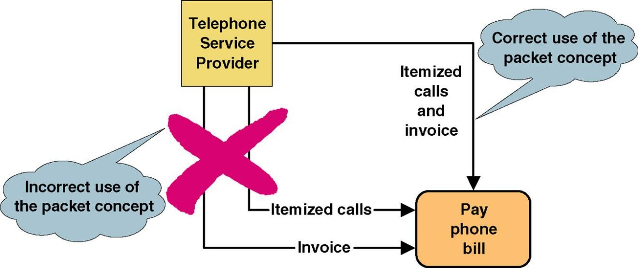
 Data that should travel together should be shown as a single data flow, no matter how many physical documents might be included.

Slide 15

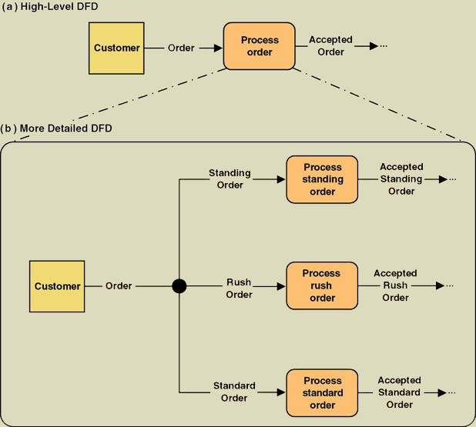
Composite flow
Elementary flows
Junction indicates that any given order is an instance of only one of
the order types.

Slide 16

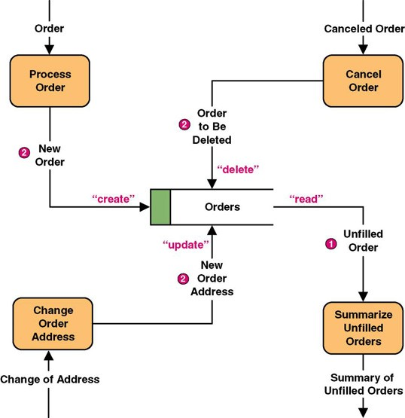

Slide 17

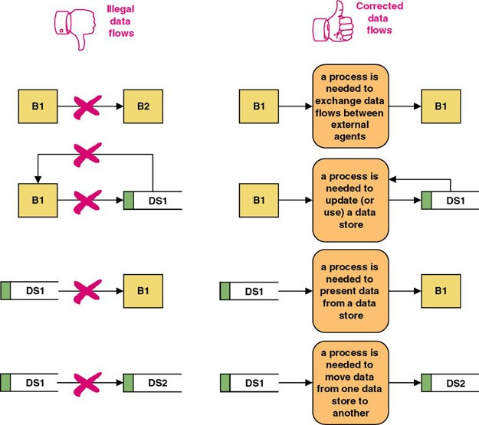
A data flow should never go unnamed.
In logical modeling, data flow names should describe the data flow without describing the implementation
All data flows must begin and/or end at a process.

Slide 18

Data conservation – the practice of ensuring
that a data flow contains only data needed by the receiving process.
Sometimes called starving the processes.
New emphasis on business process redesign to identify and eliminate inefficiencies.
Simplifies the interface between those processes.
Must precisely define the data composition of each data flow, expressed in the form of data structures.

Slide 19

Data attributes should be defined by data types and domains.
Data type - a class of data that be stored in an attribute.
Character, integers, real numbers, dates, pictures, etc.
Domain – the legitimate values for an attribute.

Slide 20

Diverging data flow – a data flow that splits into multiple data flows.
Indicates data that starts out naturally as one flow, but is routed to different destinations.
Also useful to indicate multiple copies of the same output going to different destinations.
Converging data flow – the merger of multiple data flows into a single packet.
Indicates data from multiple sources that can (must) come together as a single packet for subsequent processing.

Slide 21

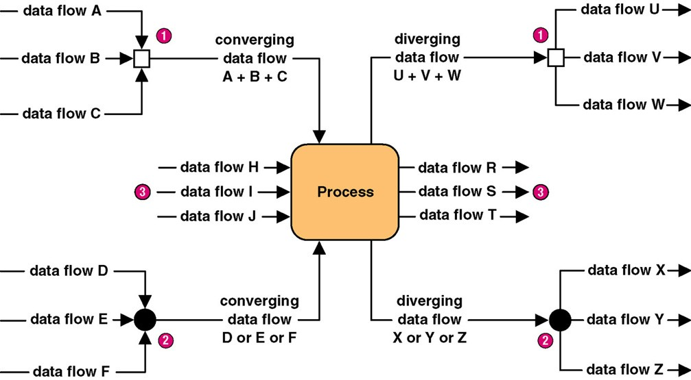

Slide 22
Example
https://www.visual-paradigm.com/tutorials/data-flow-diagram-example-food-ordering-system.jsp

Slide 23

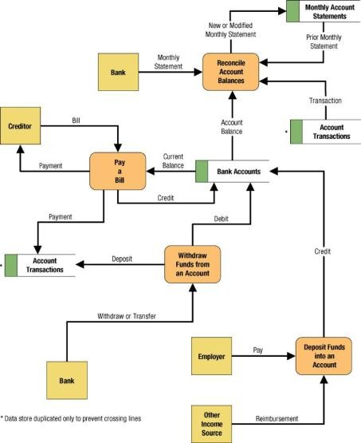
9-23

